Slide 1

BIG DATA ANALYTICS PROJECT PRESENTATION GROUP-15
TEAM MEMBERS:
MRUNAL TILEKAR - 801257239
PRATHEEKA THUMMALA - 801255442
SHIVANJANI PATHIPAKA - 801259672
SREELEKHA PASIKANTI - 801209427
VINEELA PUNURU - 801263256

Slide 2
DATA SELECTION
https://aws.amazon.com/blogs/big-data/a-public-data-lake-for-analysis-of-covid-19-data/

Slide 3
GITHUB
https://github.com/pratheeka-26/GROUP15

Slide 4
BUSINESS PROBLEM
Big data contains a massive amount of information which we can generate, store, analyze from various industries which includes the healthcare industry.
Health care industry includes hospital records, medical records of patients, results of medical examinations and infrastructure.
With strong integration of biomedical and health care data, we can possibly improve the medical therapies and personalized medicine.

Slide 5
DOMAIN KNOWLEDGE
LOWERING CHURN
CAPEX OPTIMIZATION
CROSS-SELLING
INVENTORY OPTIMIZATION

Slide 6
RESEARCH OBJECTIVES
Analyze the data using Amazon Web Services tools and resources.
Provide dashboards on total positive cases in each state based on the type of tests performed along with visualizations.

Slide 7
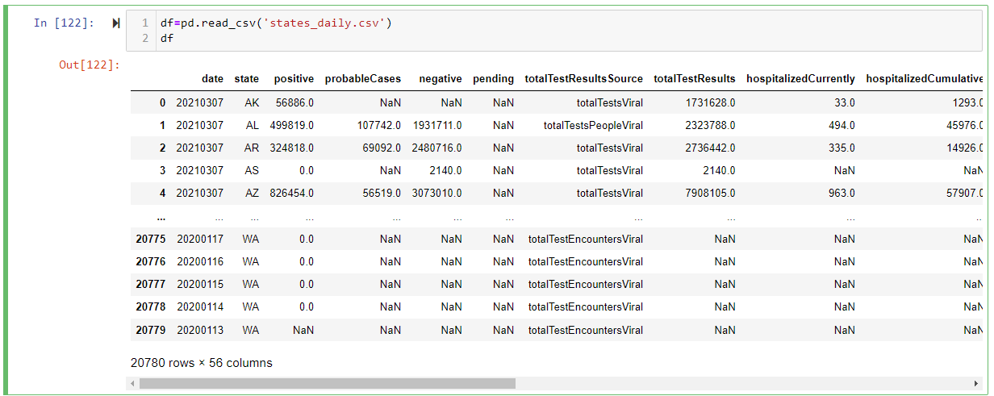
IMPORTING DATASET

Slide 8
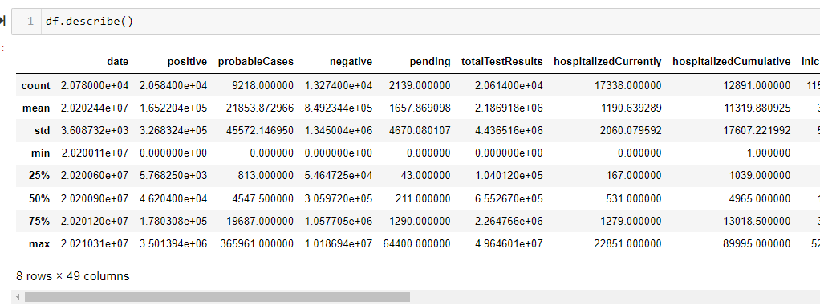
EXPLORATORY DATA ANALYSIS

Slide 9
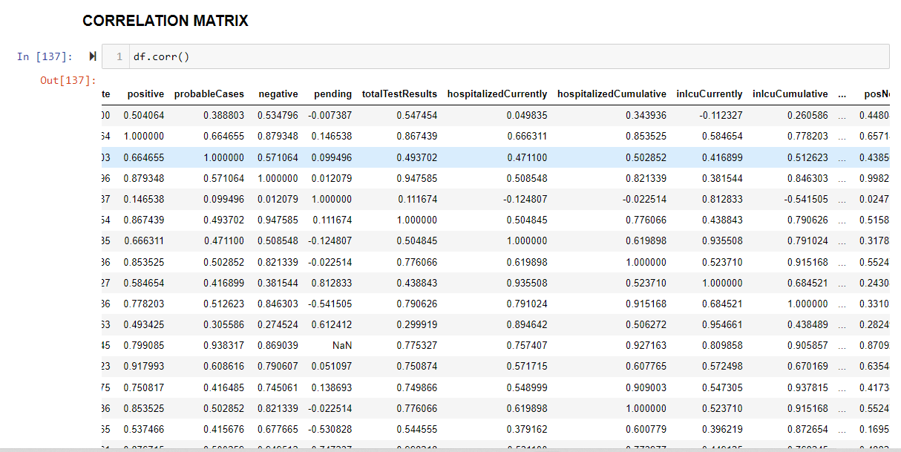

Slide 10
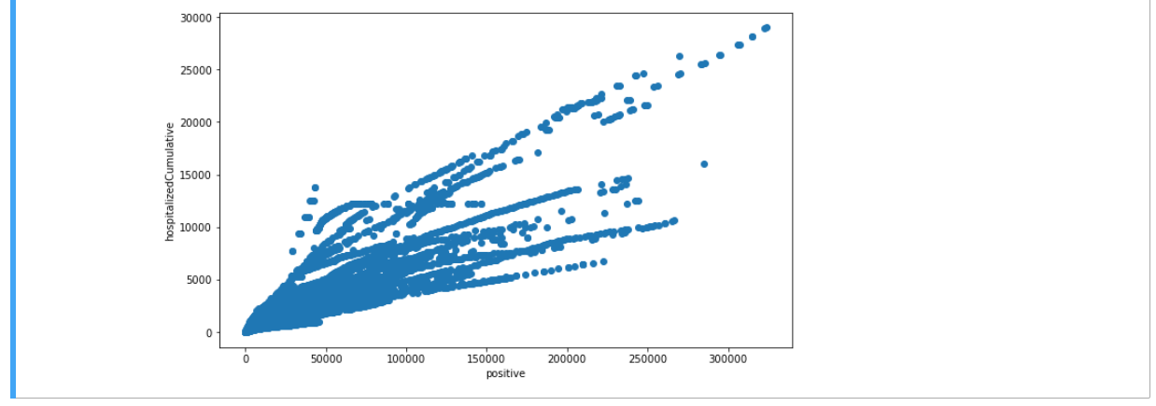
Scatter Plot of positive cases and number of people hospitalized

Slide 11
DASHBOARD
https://tinyurl.com/472bjvn6

Slide 12
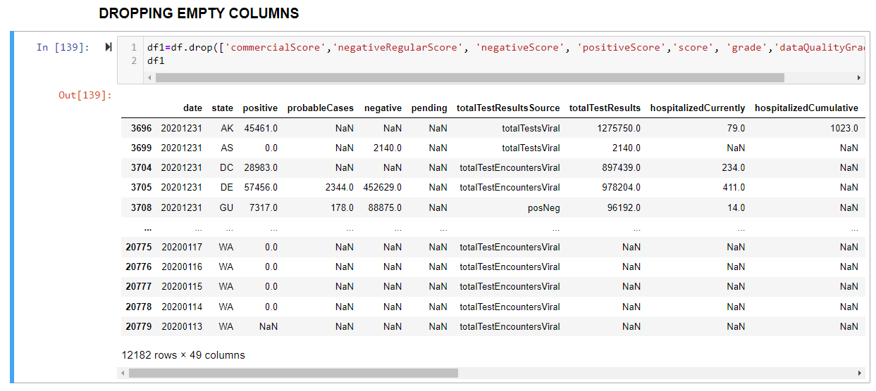
DATA PREPARATION

Slide 13
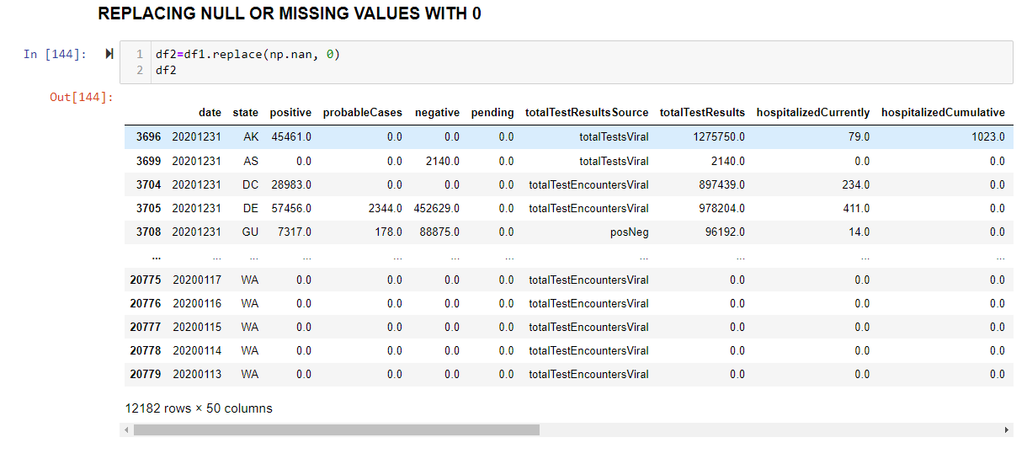

Slide 14
ANALYTICS
Date Wise Analysis
State Wise Analysis
Clustering Analysis
Analysis for a particular state NC

Slide 15
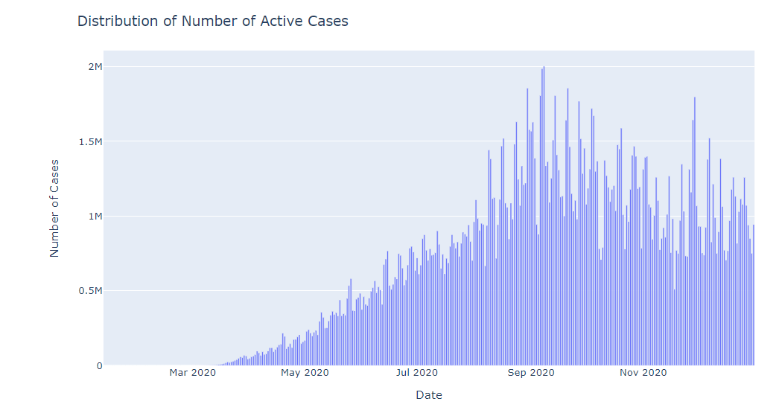
DATE WISE ANALYSIS
This plot shows the date wise analysis of the total number of active cases throughout the year.

Slide 16
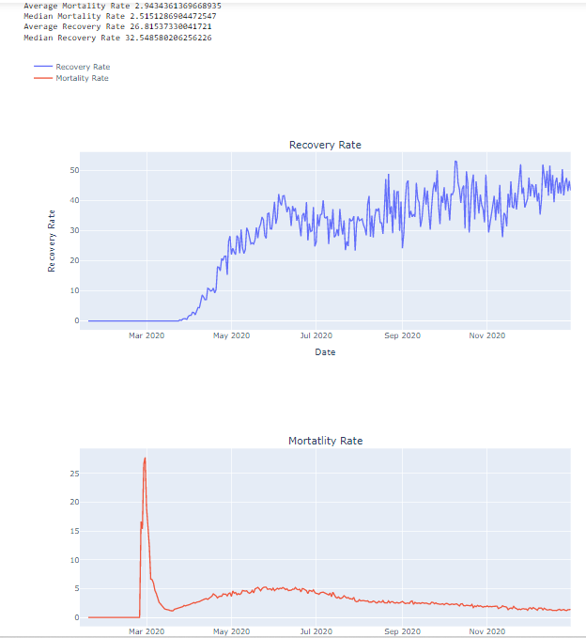
These plots show the date wise analysis of the recovery rate and mortality rate throughout the year.

Slide 17
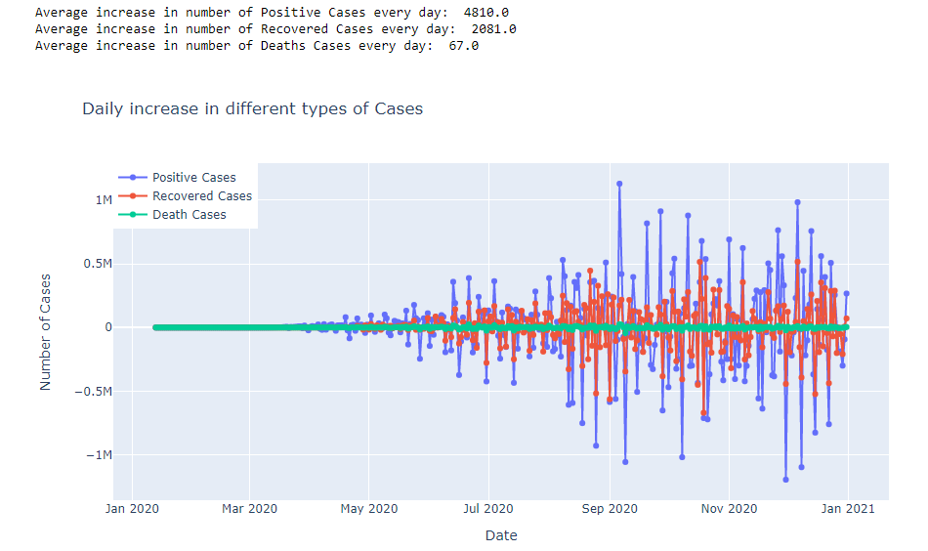
This plot shows in detail the average increase in the number of positive cases, recovered cases and deaths every day in each month.

Slide 18
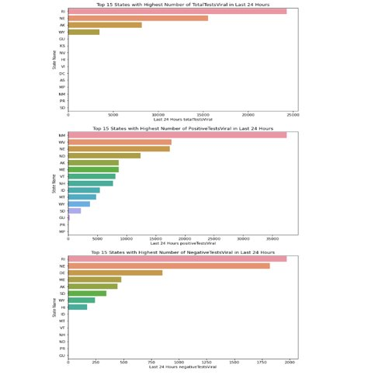
STATE WISE ANALYSIS
These plots show the highest number of TotalTestsViral, PositiveTestsViral and NegativeTestsViral in the Last 24 hours for each state.

Slide 19
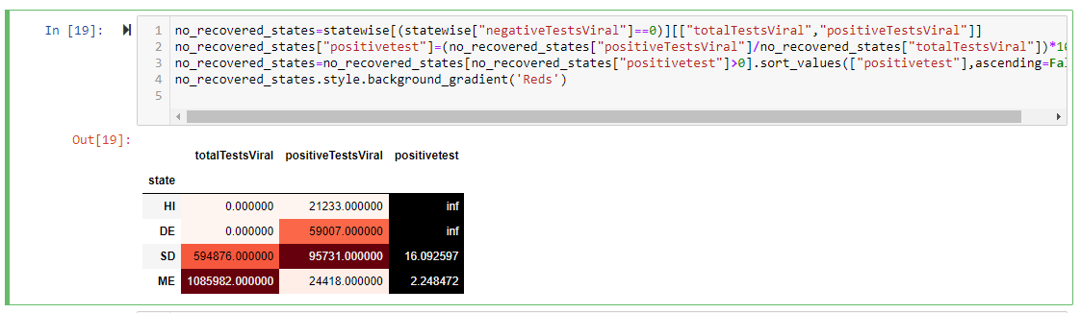
This table shows a real time analysis of the data by showing the total number of positive, negative and total tests viral for the states.

Slide 20
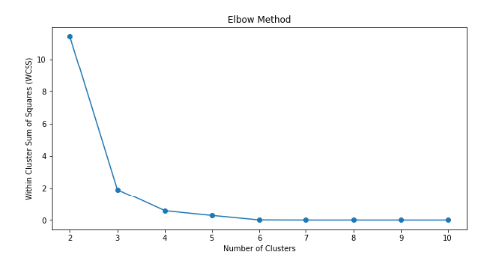
CLUSTERING ANALYSIS
This plot shows clustering analysis using the elbow method for Positive Test Viral Rate and Negative Test Viral Rate.

Slide 21
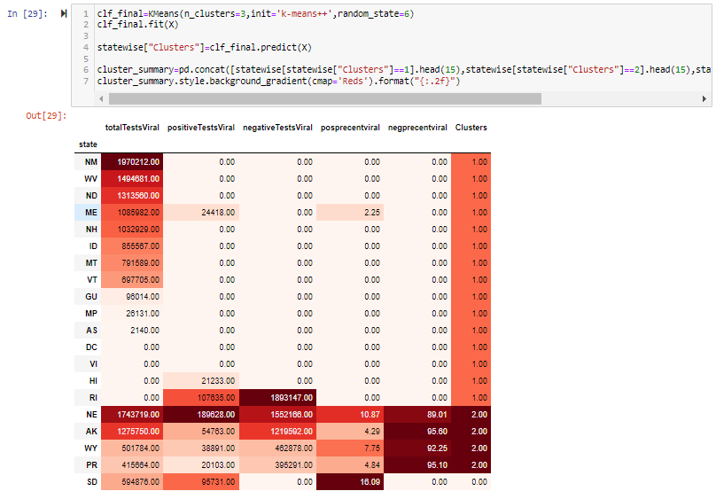
This table shows a real time analysis of the data by showing the total number of positive, negative and total tests viral along with positive percent viral and negative percent viral for all the states.​

Slide 22
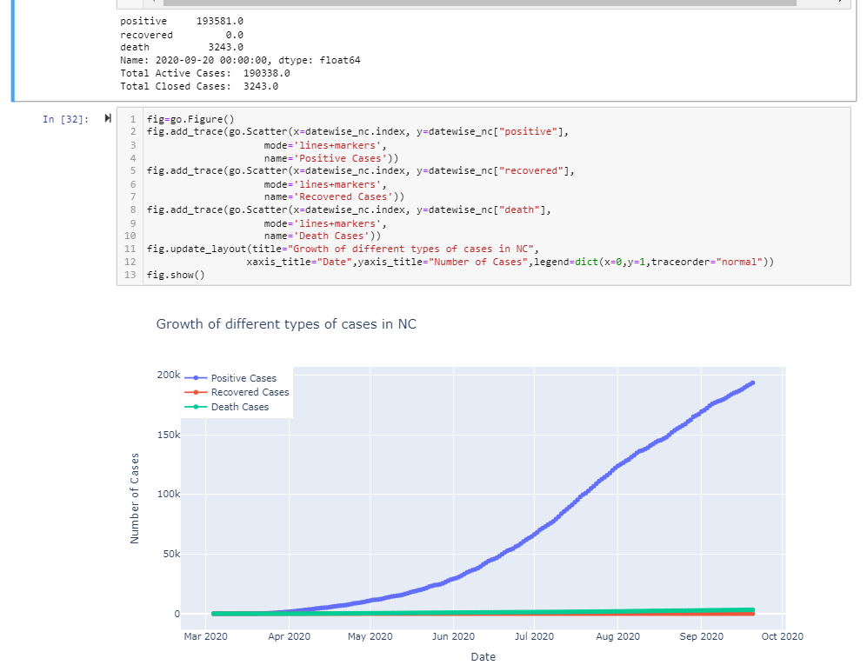
ANALYSIS FOR THE STATE NC
This plot shows positive cases, recovered cases and deaths for state NC

Slide 23
MACHINE LEARNING MODEL
Linear Regression
Polynomial Regression
Support Vector Machine Regression

Slide 24
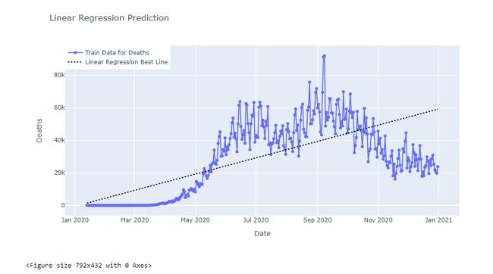
LINEAR REGRESSION
This graph is showing result of linear regression for death rate over a period of time.

Slide 25
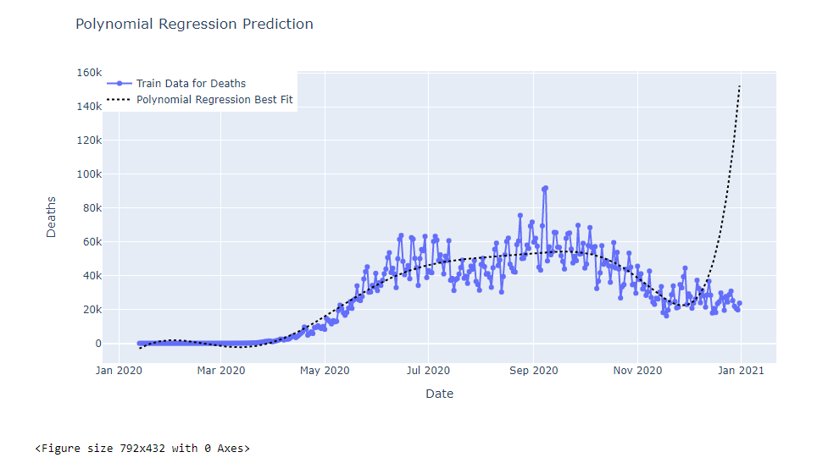
POLYNOMIAL REGRESSION
This graph is showing result of polynomial regression for death rate over a period of time.​

Slide 26
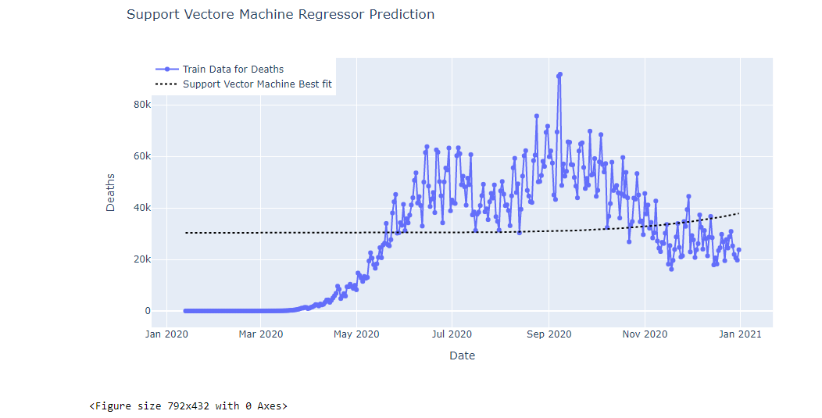
SVM REGRESSION
This graph is showing result of SVM regression for death rate over a period of time.​​

Slide 27
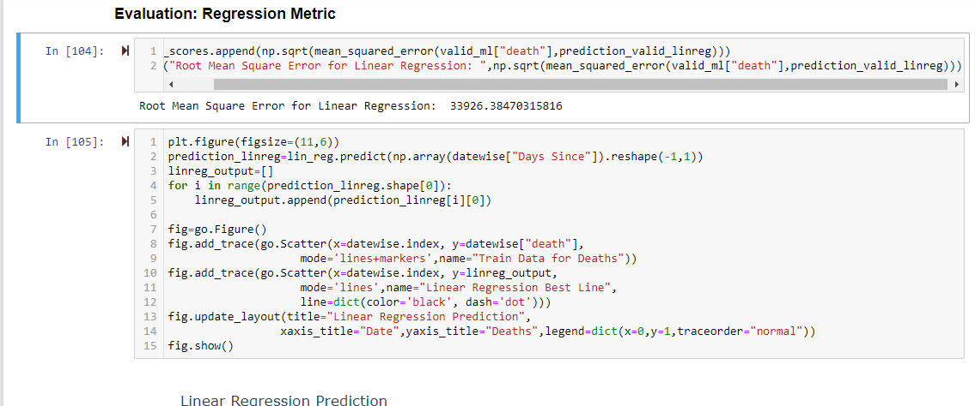
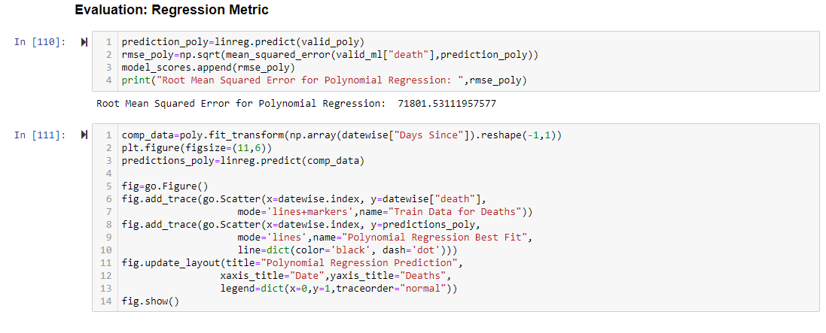
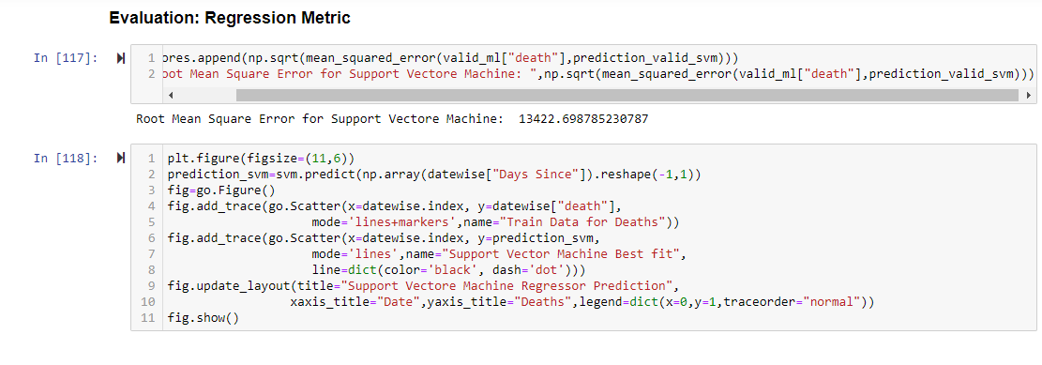
EVALUATION
Linear Regression
Polynomial Regression
Support Vector Machine

Slide 28
CONCLUSION
We analyzed our data using 3 different ML models, linear regression, polynomial regression and SVM regression.
From the value generated, we think for our data set polynomial regression model is best suited according to parameters provided.
For evaluation, we analyzed data using root mean square error.
For our data set, SVM regression gave us minimum RMS error value.

Slide 29
THANK YOU

